Slide 1
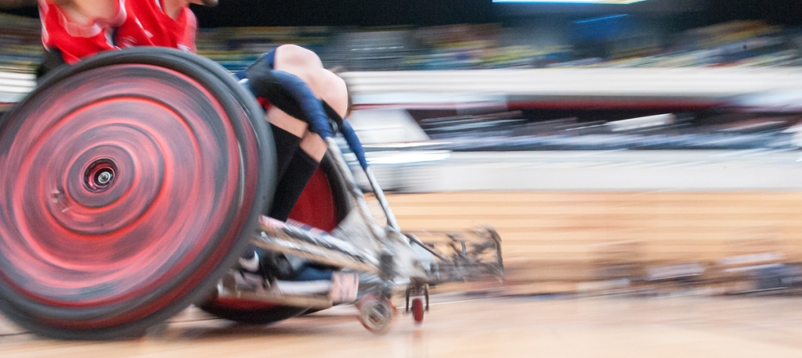
Annual General Meeting
13 July 2016 | Twickenham

Slide 2
Agenda
Chair’s Opening Address
Apologies for Absence
Minutes of the Annual General Meeting dated 15 July 2015
Actions Arising
Chair’s Annual Report
Chief Executive’s Report
National Development Director’s Review
Head Coach Paul Shaw
Performance Director’s Review
International Relations Review
Resolutions
AOB

Slide 3
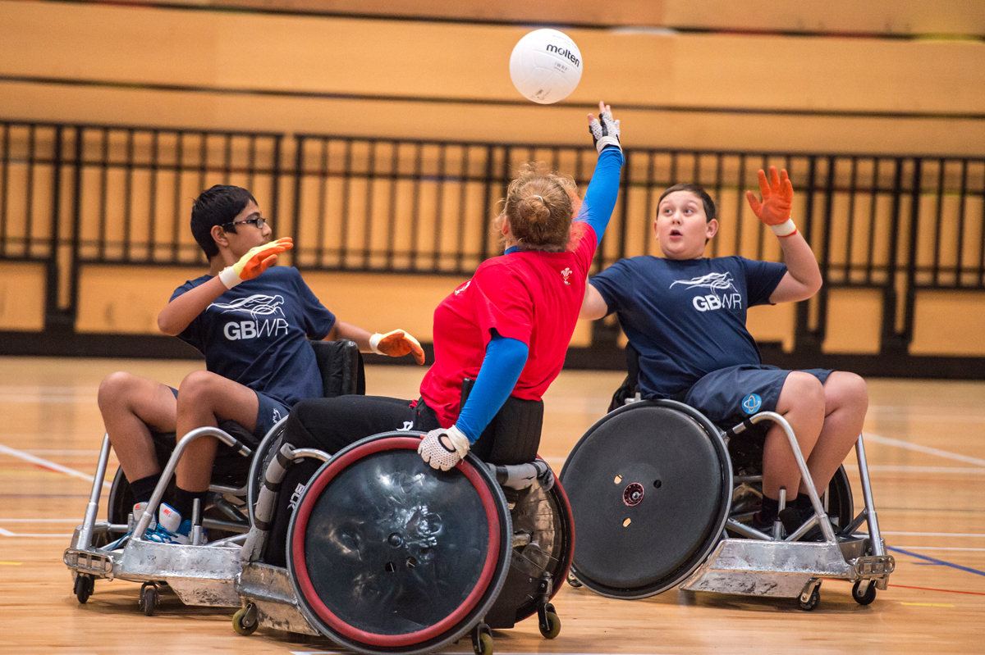
Chair’s Opening Address

Slide 4
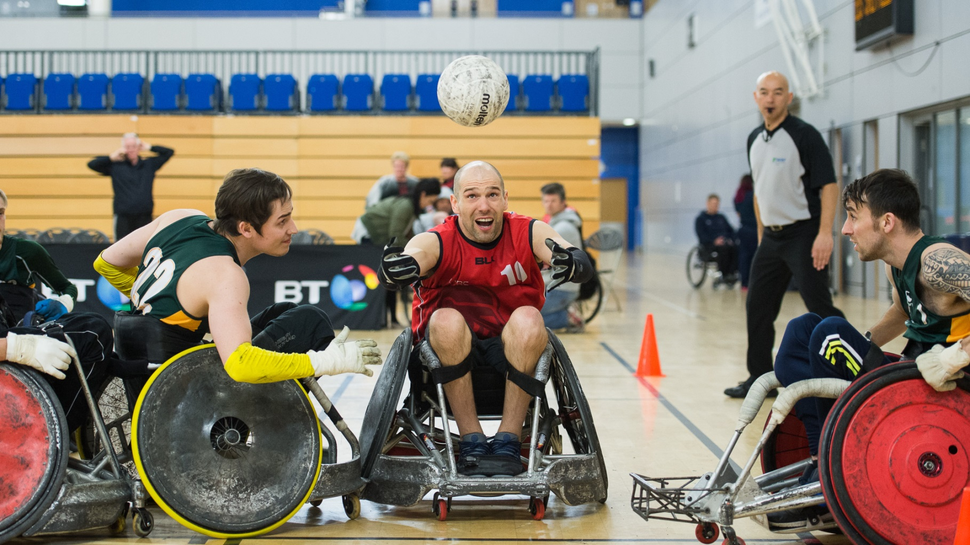
Apologies for Absence

Slide 5
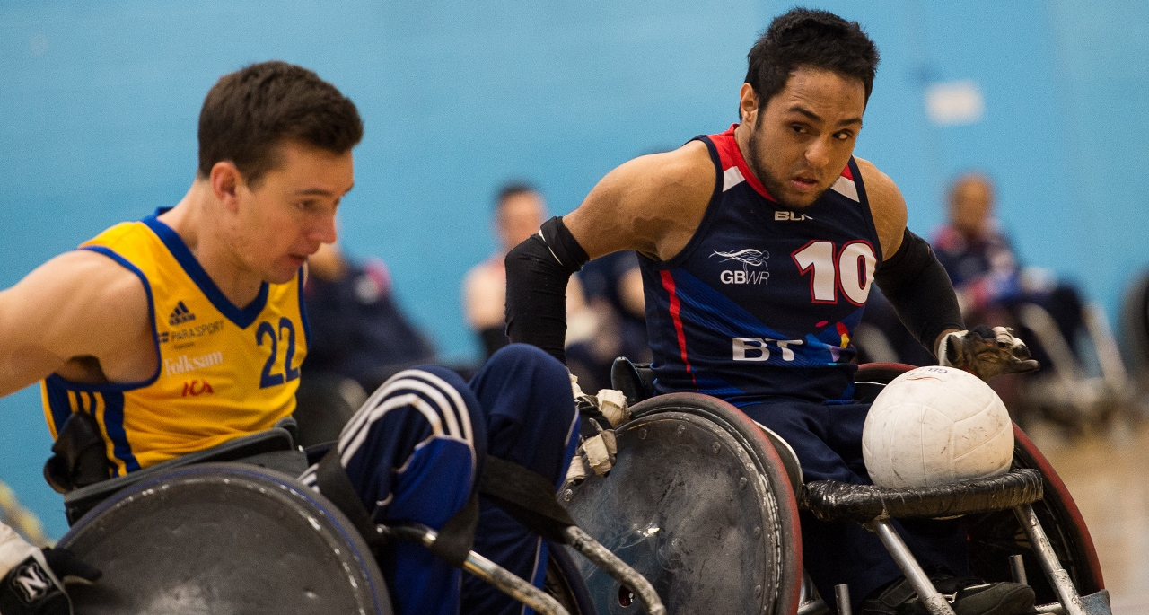
Minutes of the Annual General Meeting dated 15 July 2015

Slide 6
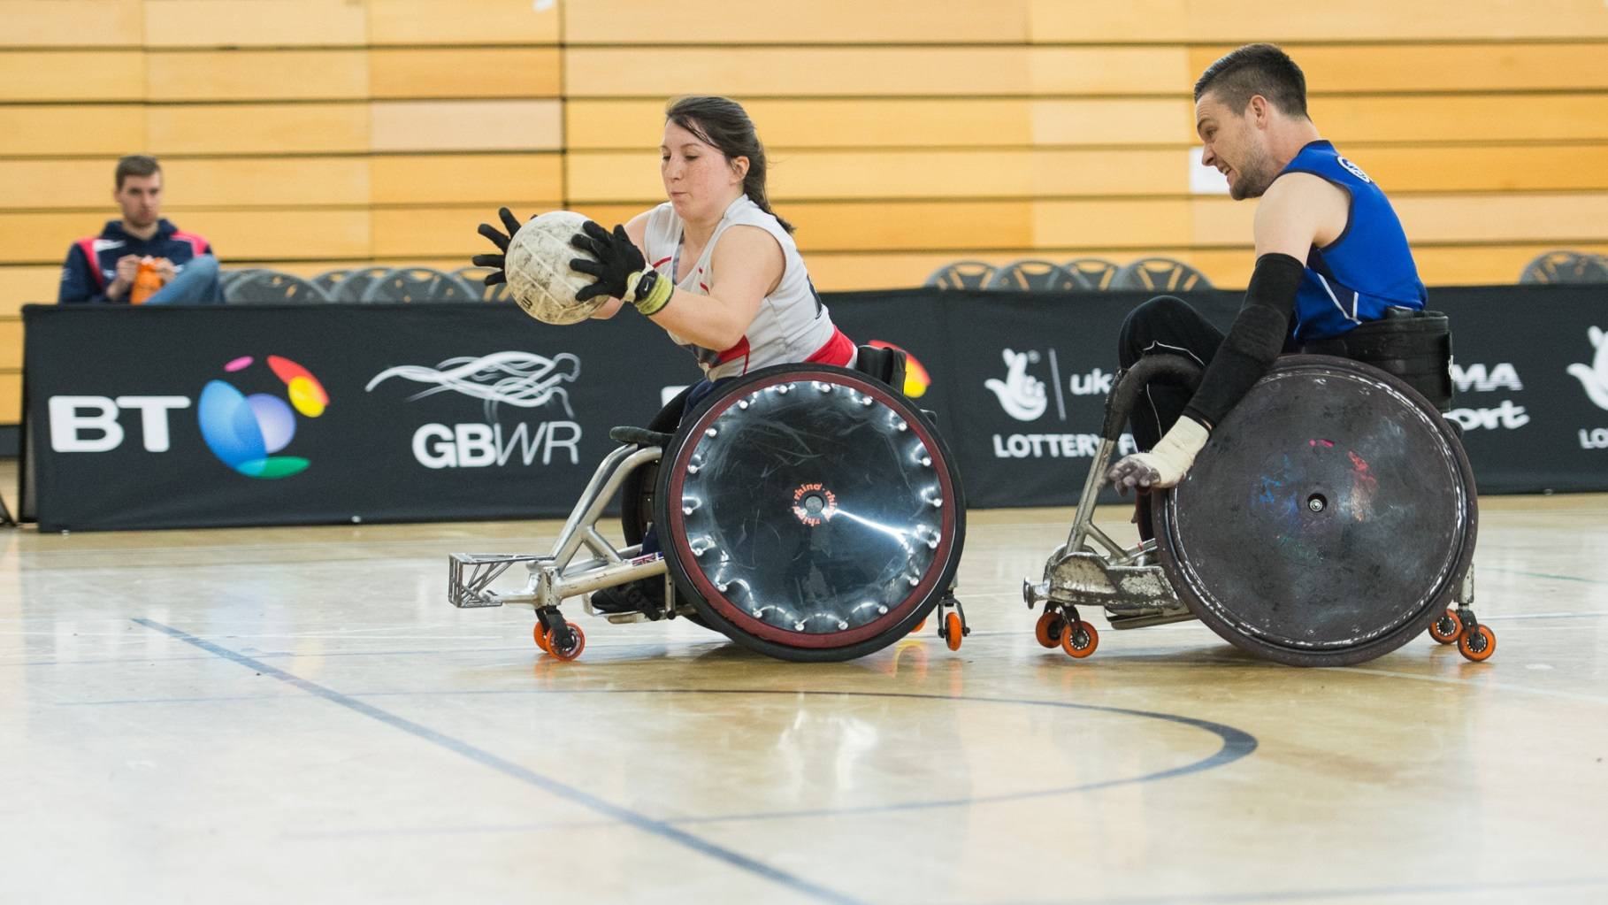
Actions Arising

Slide 7
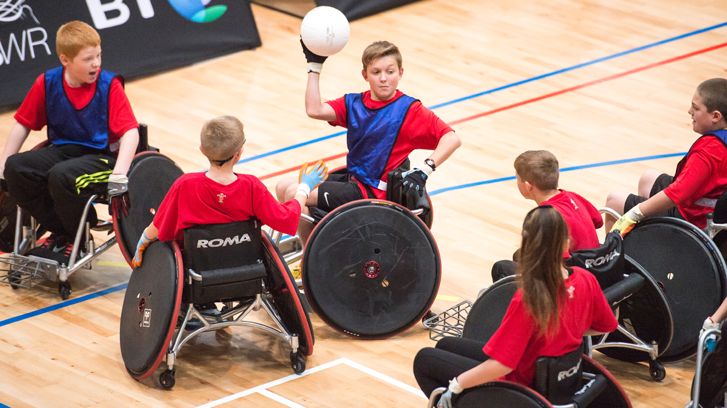
Chair’s Annual Report

Slide 8
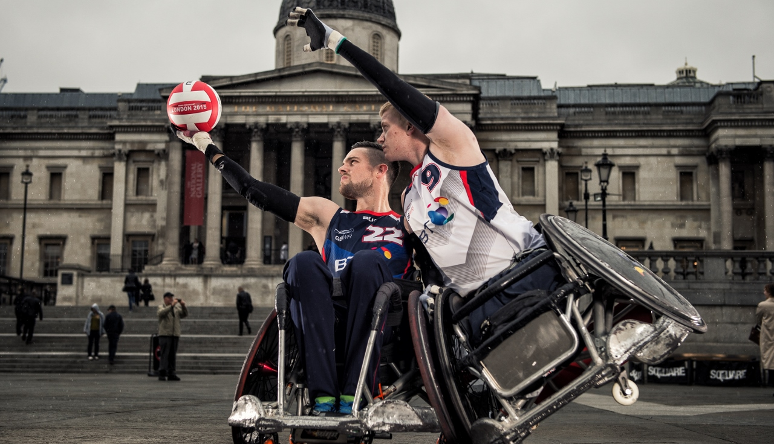
Chief Executive’s Review

Slide 9

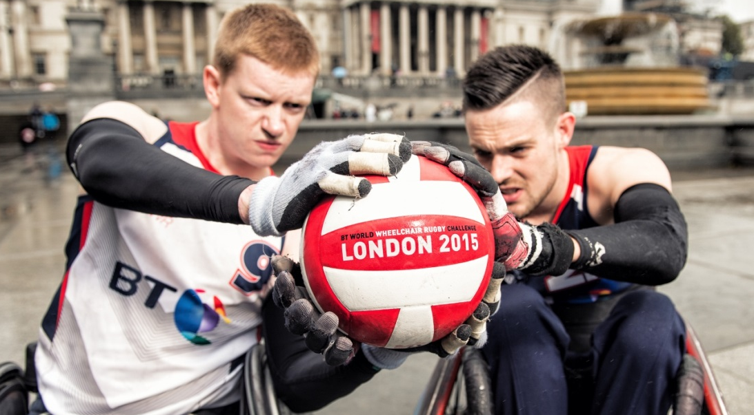
High Spots
European Gold & Rio Qualification
BT WWRC15 & Community Festival
We are still growing
BT Youth Programme
Coaching System
Quality of League
Wales
BT Partnership
Governance

Slide 10
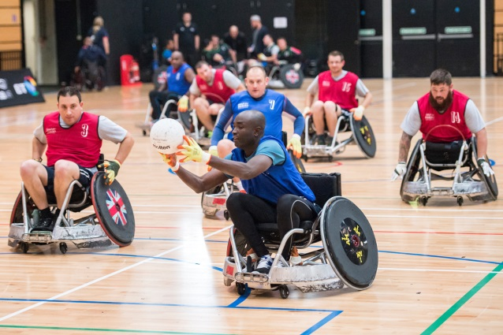
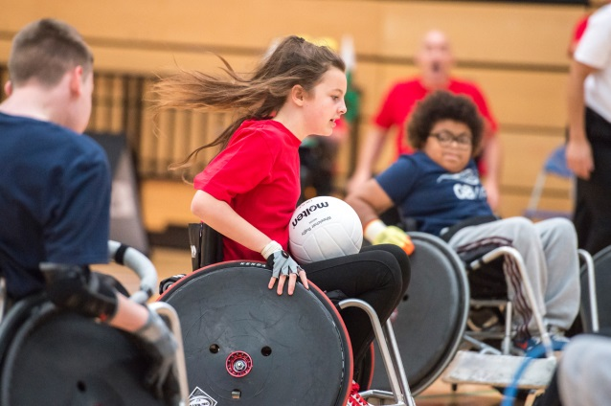
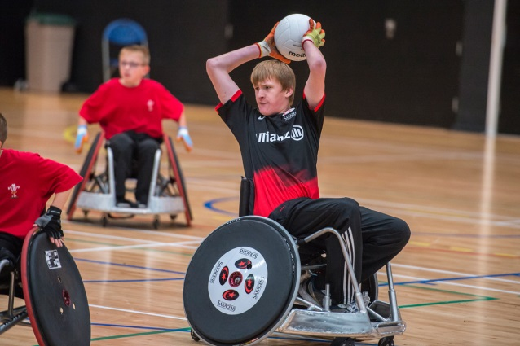
We Need to Improve
Pace of variant development
Focus on under-represented groups
Search for Talent
Club Support for Safeguarding
Balance of funding

Slide 11
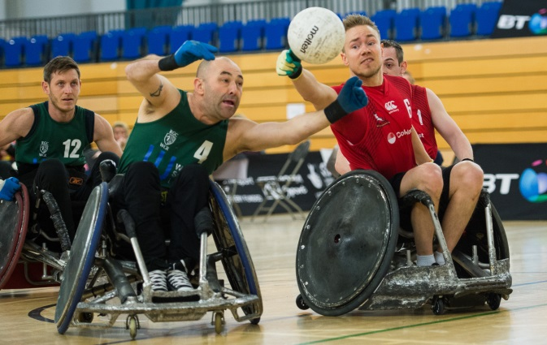
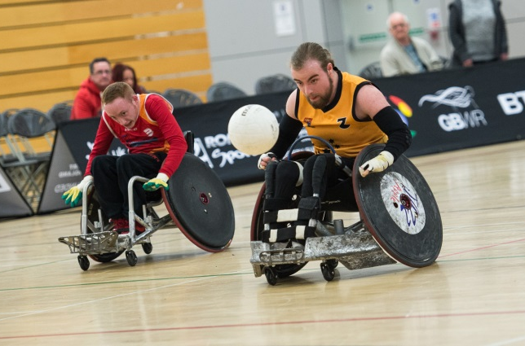
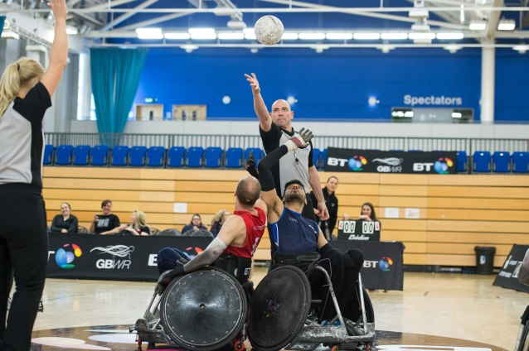
Priorities
Sport England and UK Sport Investment 2017-21
Develop new 4 year strategy
Achieve Rio Target
Club Affiliation
Workforce Development

Slide 12

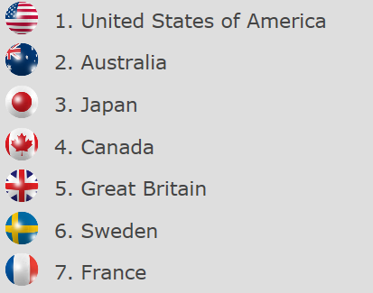
Big Challenges
Sport England’s ‘Towards An Active Nation’
Broaden funding model
World Ranking

Slide 13
















Thank You

Slide 14
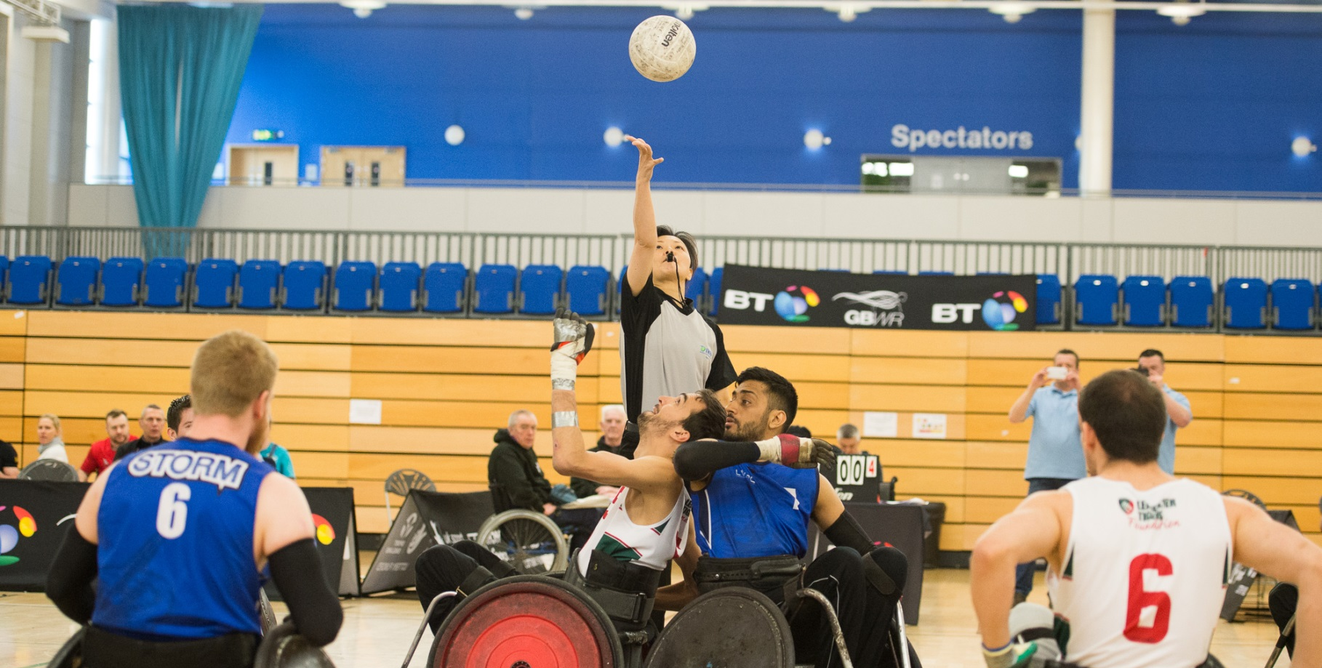
National Development Director’s Review

Slide 15
15 / 16 Headlines
Continued unprecedented growth in participation – 672 new participants
More people than ever have had the chance to try wheelchair rugby – 1631 throughput
Membership had increased to 366
Domestic competitions now run across three divisions
New clubs - Stoke Mandeville, Liverpool, Yorkshire and Brighton
Increased funding in Wales
First ever Youth Tournament – Full development of youth programme
First ever female only tournament – Supporting This Girl Can
Workforce:
  First ever 1st4Sport Level 2 Wheelchair Rugby Coaching course
  Full programme of officiating workshops and clinics – including testing
  Officiating team have increased to 29
Initial variant design
We continue to deliver more opportunities, in more places, to more people!
Thank you to the Domestic Management Group

Slide 16
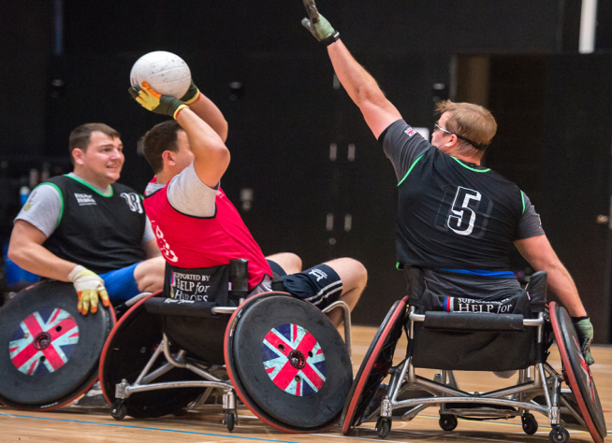
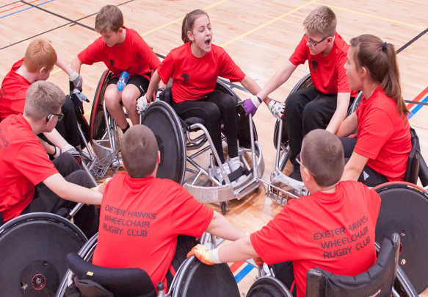
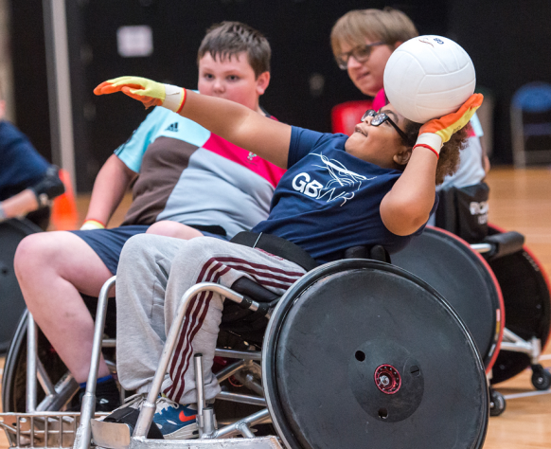
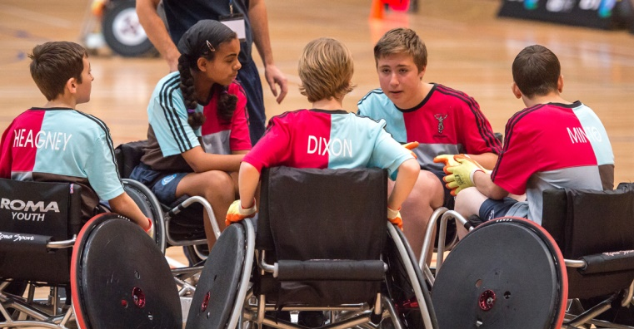
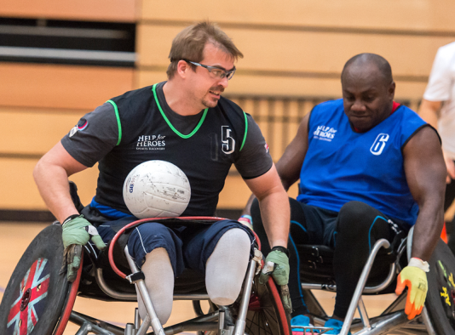

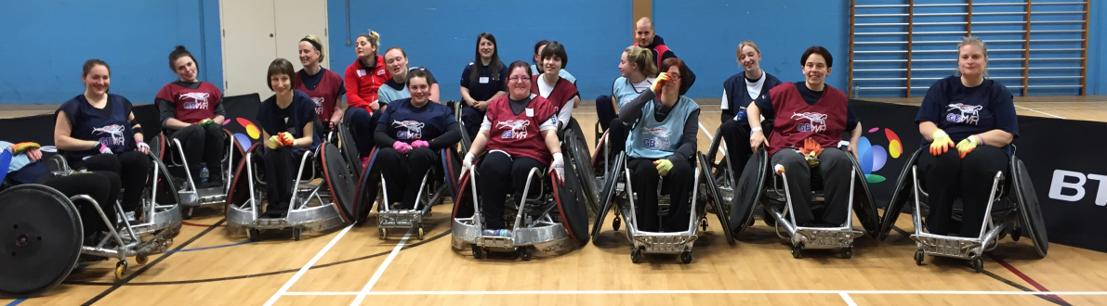

Slide 17
16 / 17 Focus
Develop and submit plan for 2017 – 2021 Sport England investment
Continue effective positioning of the sport with key partners
Achievement of Advanced safeguarding standard
Increase the number of clubs across the country – appropriate coverage
Develop and deliver a series of key programmes in Wales with new funding streams
Continue to deliver BT Youth Programme - with National and Regional Tournaments
Deliver game variant pilot
Ensure successful roll-out of club accreditation programme
Continue to increase quality and quantity of competition aligned to growth of the sport
Workforce:
  Second International Classifier
  Run full accredited officiating education programme
  Deliver first full programme of accredited coaching qualifications
  Become recognised coach education centre

Slide 18

Head Coach Paul Shaw

Slide 19
Performance Director’s Review

Slide 20
15 / 16 Headlines
European Champions, and Rio Paralympic Qualification
Other International Competition – Firmly no.1 Europe, and mixing it with World Top 4
Pathway Development
  9 Talent Athletes, International Classification
  Talent Development Squad
  Two regional talent training groups
Lilleshall, confirmed as our Elite Training centre
  More accessible rooms
  Better access to old building
  Performance Equipment installed in training hall
Health and Well Being – reduced training days lost
  Skin care
Science and Innovation
  PHC, testing field and lab
  Chair development ROMA
  Preparation
    Recovery
    Cooling

Slide 21


Slide 22
16 / 17 Focus
RIO 2016 – Paul Already provided an update on this
Looking forward:
Performance Strategy 2020, and Beyond
  Building on the great foundations built within the Rio Cycle
  Sustainable Pathway
  Bigger talent pool, more athletes year on year challenging for elite selection
Rio 2016 Review processes and final UKS and SE funding submissions
January 2017, start of new cycle
  Open selection camp, applications submitted and athletes invited to 1st selection camp January 2017
  Final selection camp March 2017, 15 athletes named on elite programme for 2017
  Early European Championships June or July? … part of a longer - two year team development programme for Worlds 2018 in Australia
  HUGE thank you to the performance and talent staff, and athletes

Slide 23
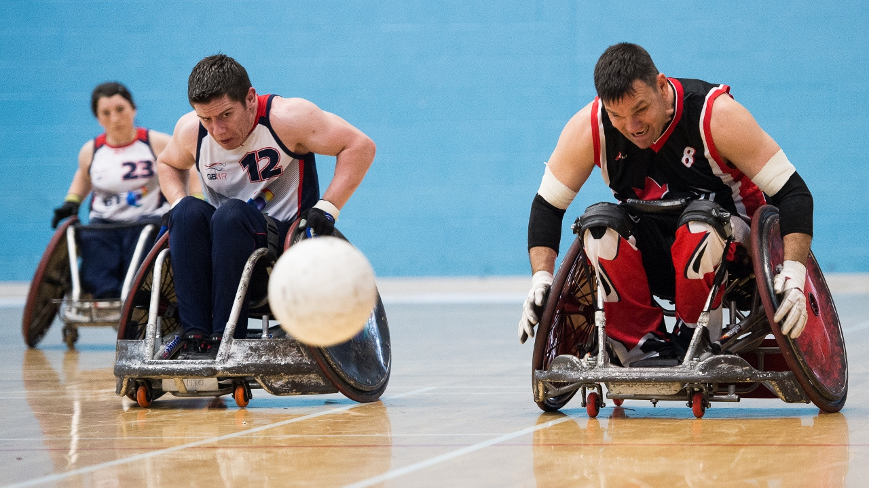
International Relations Review

Slide 24
Strategic Objectives
Support the direction of international major events
Support the IWRF Board
IWRF to engage with wheelchair rugby variants
Support and influence the IWRF and IPC in the further development of sport classification
Support and influence the strengthening of the European zone
Identify and promote GBWR candidates for international positions

Slide 25
Resolutions
Resolution 1.
THAT the accounts for the financial year ended 31 March 2016 together with the reports of the Trustees and auditors be adopted.
Resolution 2.
THAT Mazars, Tower Bridge House, St Katherine’s Way London E1W 1DD be re-appointed as the Company’s Auditors, to hold office until the conclusion of the next Annual General Meeting.
Resolution 3.
THAT Mrs Margaret Moore be appointed as a Trustee for a period of up to 3 years.
Resolution 4.
THAT Mr Andrew Flatt be re-appointed as a Trustee for a period of up to 3 years.
Resolution 5.
THAT Mr Richard Allcroft be re-appointed as a Trustee for a period of up to of 3 years.

Slide 26

Any Other Business
None received

